Slide 1
Major past reforms of the Common Agricultural Policy (CAP):
https://www.europarl.europa.eu/factsheets/en/sheet/107/the-common-agricultural-policy-instruments-and-reforms
The post-2021 CAP:
https://ec.europa.eu/info/food-farming-fisheries/key-policies/common-agricultural-policy/new-cap-2023-27_en

Slide 2
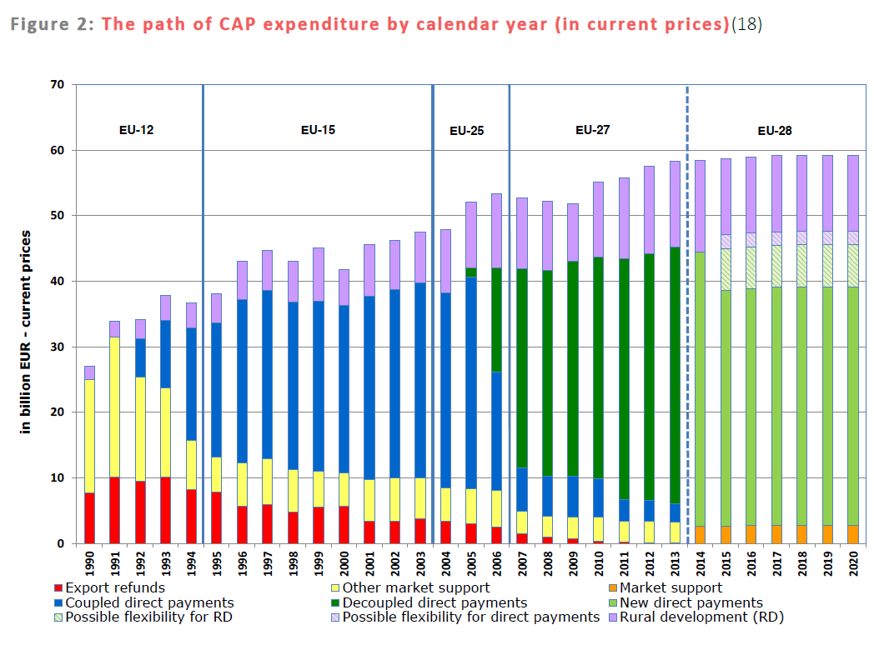
Source: Bailey, A., Lang, T., & Schoen, V. (2016). Does the CAP still fit?.

Slide 3
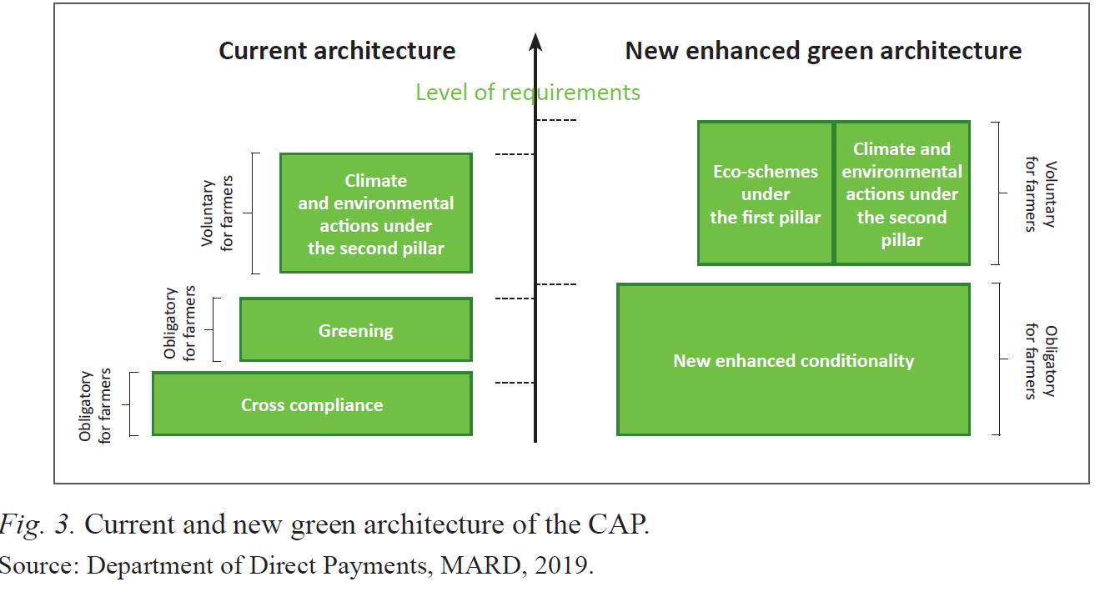

Slide 4
Daugbjerg, C., & Feindt, P. H. (2017). Post-exceptionalism in public policy: transforming food and agricultural policy. Journal of European Public Policy, 24(11), 1565-1584.
Examples of policy innovations in agri-food policy [shaping the trend in CAP reforms]:
the move from price support through market intervention to income support through less production and trade-distorting direct payments
the introduction of agro-environmental policies.
Under the influence of market liberalism, the general direction has been a move away from market-distorting instruments (guaranteed floor prices, production- linked direct payments and comparatively high tariffs), making agriculture less exceptional in this regard.
Though reformed, the instruments remain sector-specific but are increasingly linked to public interest concerns. For instance:
direct payments have been linked to specific conservation practices (‘greening’)
or to compliance with established or new regulations (‘cross compliance’)
and agro-environmental programs that incentivize specific farming practices have been introduced.

Slide 5
Task. Based on the article and slides on CAP reforms since the 1980s, please identify the main trends and most decisive steps as regards
the ways farmers’ income is supported
the extent of integration of environmental concerns in the CAP and the policy tools used for this purpose
The room for maneuver left to national governments to adapt CAP measures to their different national and regional contexts (subsidiarity)
The role that a closed policy network of actors sharing the common idea that “agriculture is different” (exceptionalism) played in environmental integration in the CAP

